Slide 1
Computer Vision
Part 2: Variational Autoencoder
ADF

Slide 2

Agenda
Part 1: Deep Dream and Style Transfer
Part 2: Variational AutoEncoder
Part 3: Generative Adversarial Network
Computer Vision

Slide 3
Supervised vs Unsupervised
Computer Vision

Slide 4
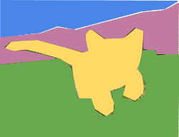
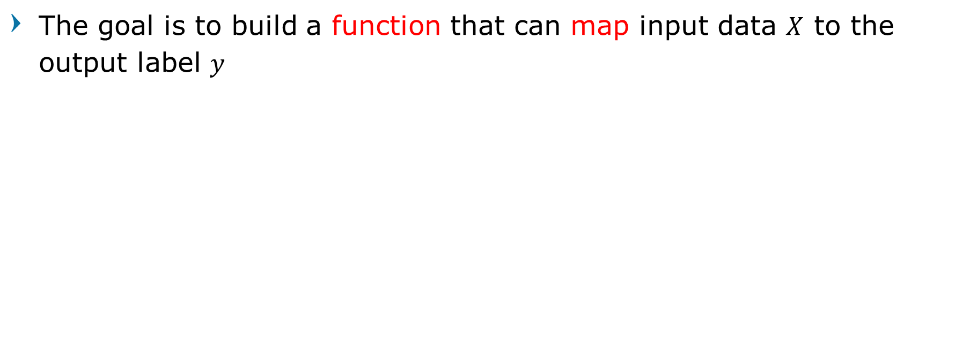
Supervised Learning
The goal is to build a function that can map input data $X$ to the output label $y$
Classification
Object Detection
Semantic Segmentation
Image captioning
Cat
DOG, DOG, CAT
GRASS, CAT, TREE, SKY
A cat sitting on a
suitcase on the floor
Computer Vision

Slide 5
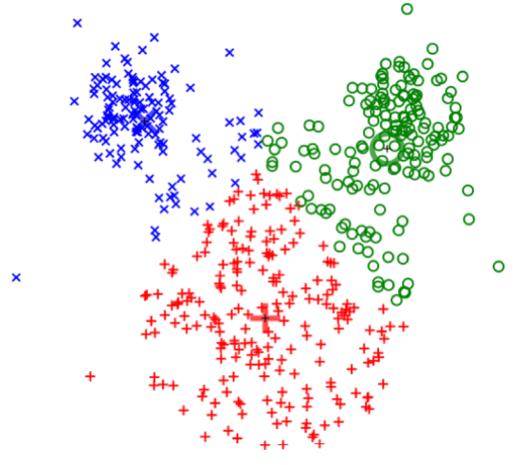
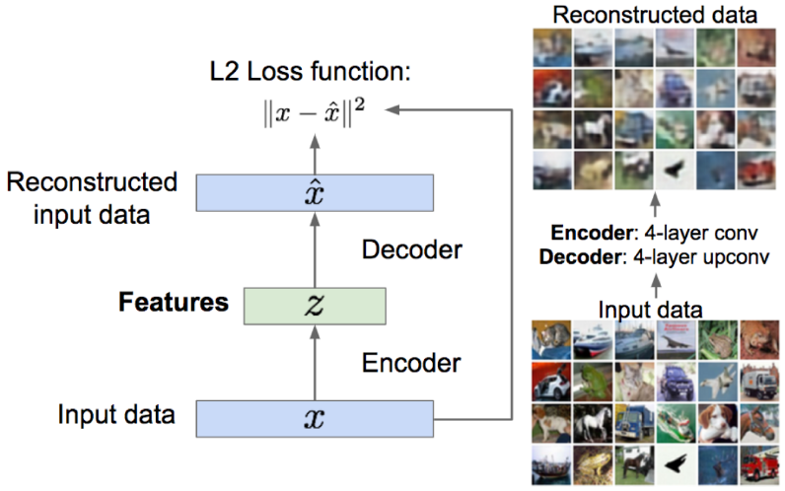
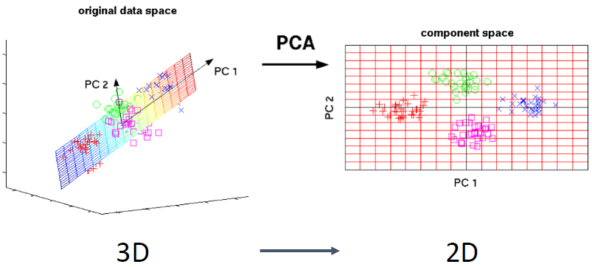
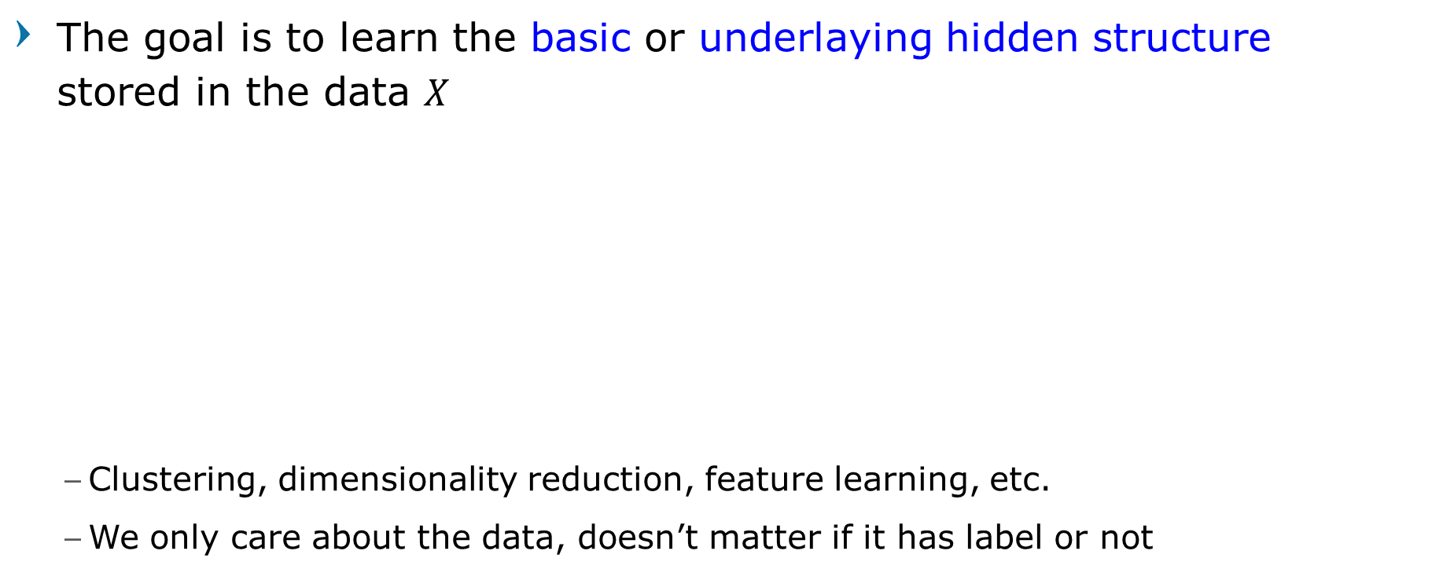
Unsupervised Learning
The goal is to learn the basic or underlaying hidden structure stored in the data $X$
Clustering, dimensionality reduction, feature learning, etc.
We only care about the data, doesn’t matter if it has label or not
Dimensionality Reduction
(e.g. Principal Components Analysis)
Feature Learning
(e.g. autoencoders)
Clustering (e.g. K-Means)
Computer Vision

Slide 6
Expensive Process in Supervised
The most expensive process in Supervised Learning is labeling data
Manual, repetitive, taxing, and boring
The existence of raw unlabeled data is very abundant
The purpose of Unsupervised Learning is to process unlabeled data
Computer Vision

Slide 7
Holy Grail of Unsupervised
Unsupervised feature learning
Have huge dataset with no label
Using a combination of all raw data to learn and recognizes the basic structure of the data in general (not specific to one case / one type of data)
With this recognized structure, we can use it to solve various cases and problems (one-for-all)
Computer Vision

Slide 8
Generative Models
What indicates that a model has learned, recognized, and understood the structure of a data?
Computer Vision

Slide 9
Generative Models
A model is considered to understand data if
Given a training data, it can generate/produce data that is completely new but with the distribution of attributes that are the same/similar to the original data
In statistic, you need the mean and variance
Computer Vision

Slide 10
Generative Models
Computer Vision

Slide 11
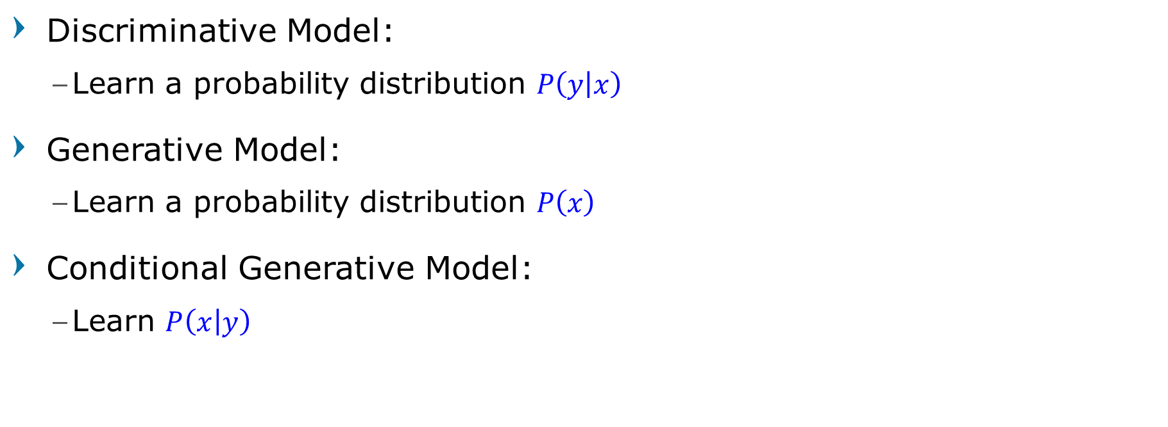
Discriminative vs Generative Models
Discriminative Model:
Learn a probability distribution $P\left(y | x\right)$
Generative Model:
Learn a probability distribution $P\left(x\right)$
Conditional Generative Model:
Learn $P\left(x | y\right)$
Computer Vision

Slide 12
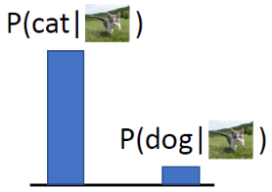
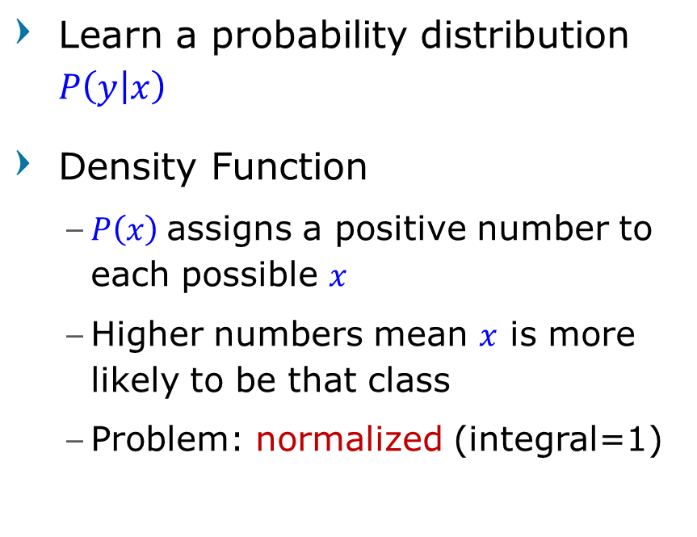
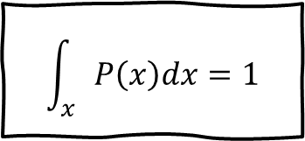
Discriminative Models
Data: x
Learn a probability distribution $P\left(y | x\right)$
Density Function
$P\left(x\right)$assigns a positive number to each possible $x$
Higher numbers mean $x$ is more likely to be that class
Problem: normalized (integral=1)
$$\int_{x}{P\left(x\right)dx}=1$$
Computer Vision

Slide 13
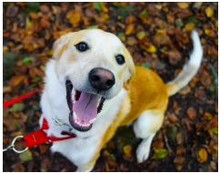
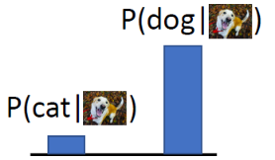
Discriminative Models
Data: x
The possible labels for each input ”compete” for probability mass.
But no competition between images
Computer Vision

Slide 14
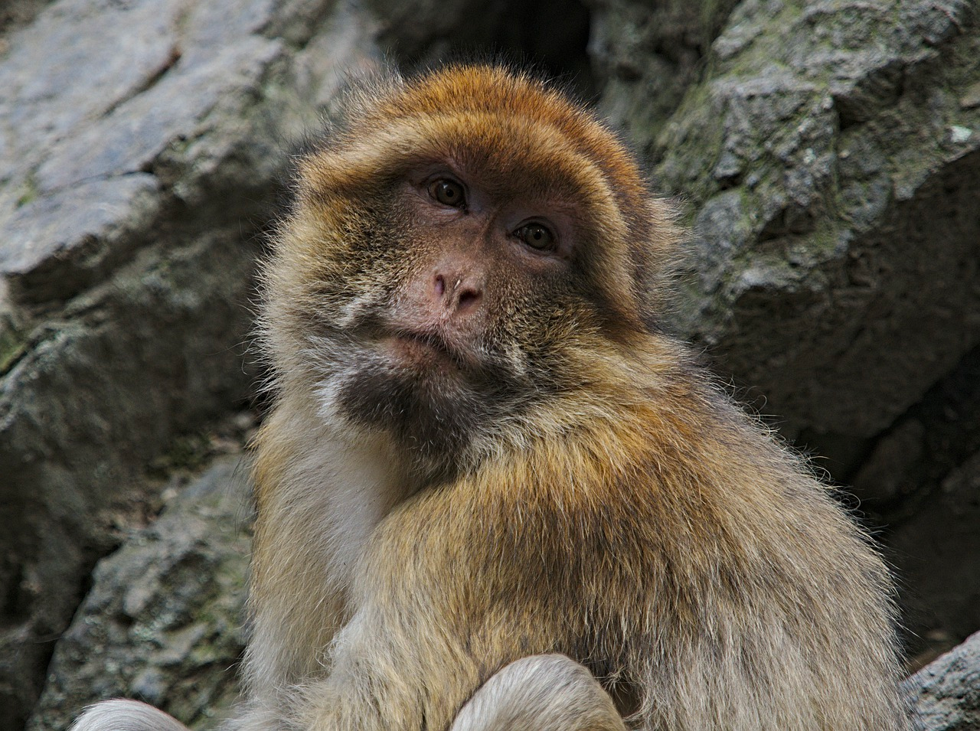
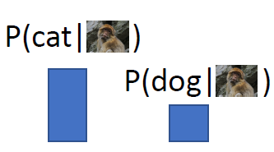
Discriminative Models
Data: x
No way for the model to handle unreasonable inputs
It must give label distributions for all images
Computer Vision

Slide 15
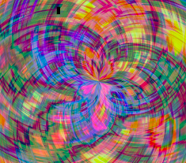
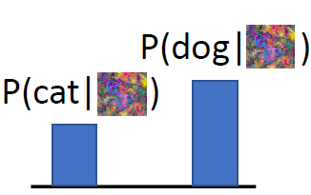
Discriminative Models
Data: x
No way for the model to handle unreasonable inputs
It must give label distributions for all images
Computer Vision

Slide 16
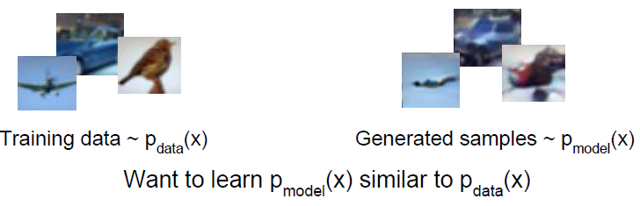
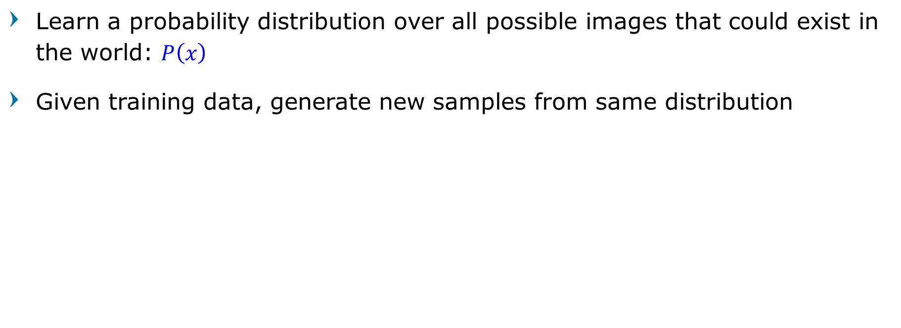
Generative Models
Learn a probability distribution over all possible images that could exist in the world: $P\left(x\right)$
Given training data, generate new samples from same distribution
Computer Vision

Slide 17
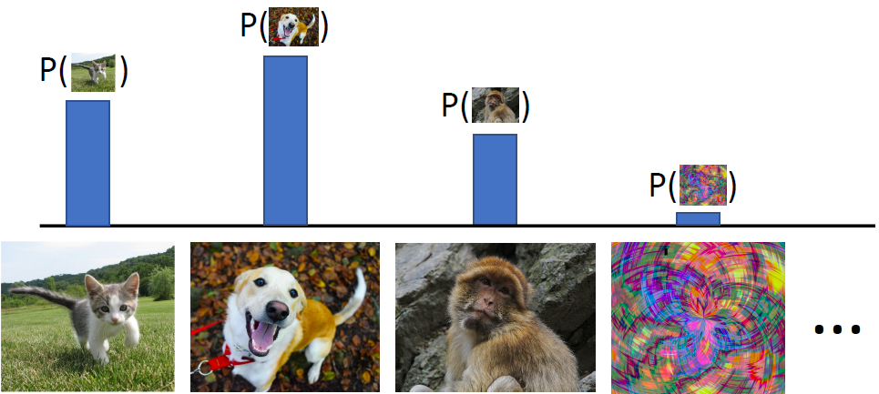
Generative Models
All possible images compete with each other for probability mass
Computer Vision

Slide 18
Generative Models
Assign number of how likely the image exists
All possible images compete with each other for probability mass
Computer Vision

Slide 19
Generative Models
Model can “reject” unreasonable inputs by assigning them small values
Requires deep image understanding! Is a dog more likely to sit or stand? How about 3-legged dog vs 3-armed monkey?
Computer Vision

Slide 20
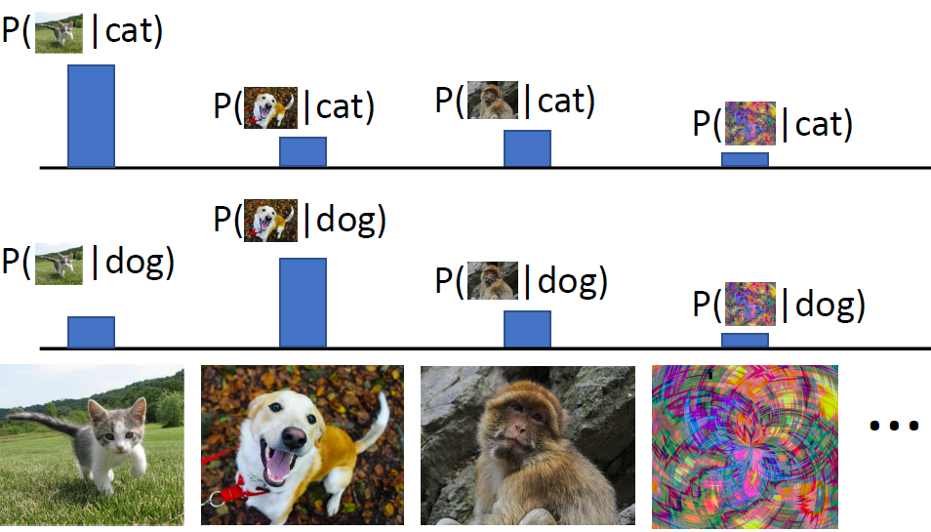
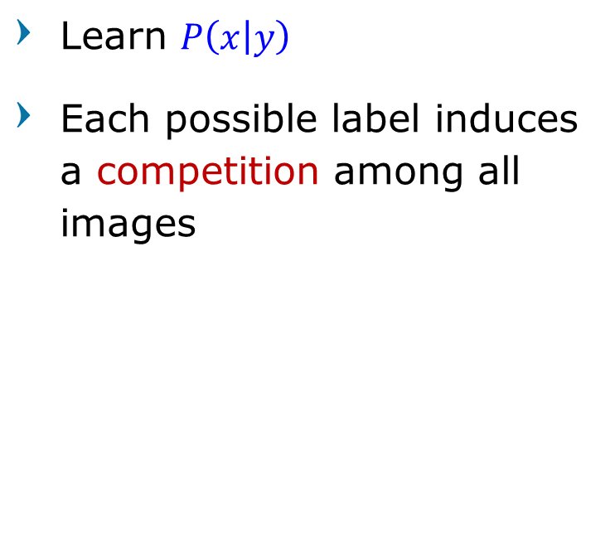
Conditional Generative Model
Learn $P\left(x | y\right)$
Each possible label induces a competition among all images
Computer Vision

Slide 21
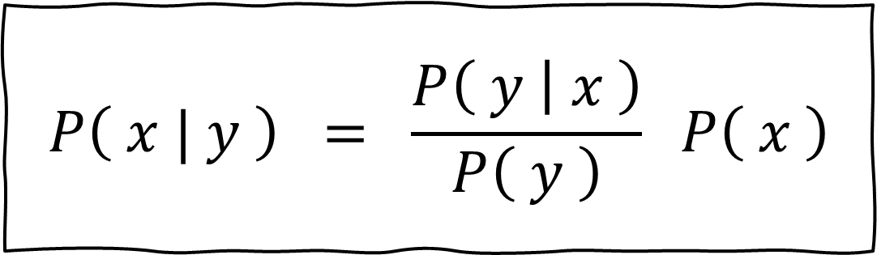
Recall Bayes’ Rule
Discriminative Model
$$P\left( x | y \right) = \frac{P\left( y | x \right)}{P\left( y \right)} P\left( x \right)$$
(Unconditional)
Generative Model
Conditional
Generative Model
Prior over labels
Computer Vision

Slide 22
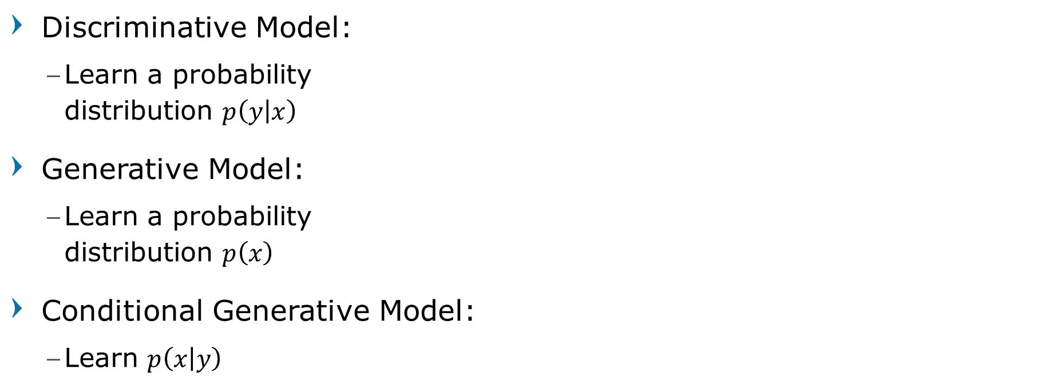
Discriminative vs Generative Models
Discriminative Model:
Learn a probability distribution $p\left(y | x\right)$
Generative Model:
Learn a probability distribution $p\left(x\right)$
Conditional Generative Model:
Learn $p\left(x | y\right)$
Assign labels to data
Feature learning (supervised)
Detect outliers
Feature learning (unsupervised)
Sample to generate new data
Assign labels, while rejecting outliers!
Generate new data conditioned on input labels
Computer Vision

Slide 23
Why Generative Models?
Realistic samples for artwork, super-resolution, colorization, stitching, deblurring, etc.
Generative models of time-series data can be used for simulation and planning (reinforcement learning applications!)
Outlier detection in the distribution, use outliers during training to improve even more
Training generative models can also enable inference of latent representations that can be useful as general features
Computer Vision

Slide 24
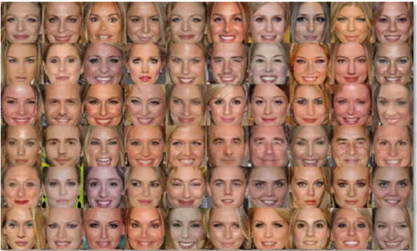
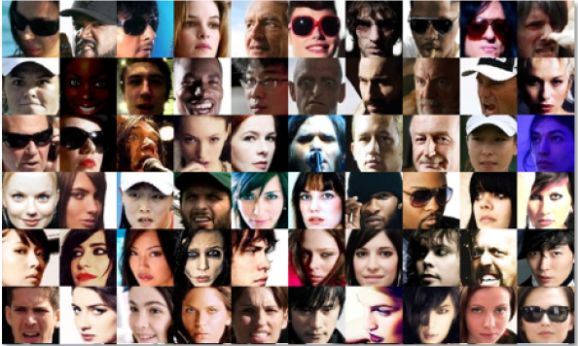
Why Generative Models?
Debiasing problem
Capable of uncovering underlying features in a dataset
Homogeneous skin color, pose
Diverse skin color, pose, illumination
Computer Vision

Slide 25
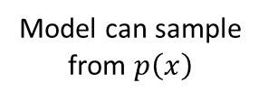
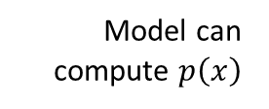
Taxonomy of Generative Models
Generative Models
Implicit Density
Direct
Generative Adversarial Network
Model can sample from $p\left(x\right)$
Model can compute $p\left(x\right)$
Explicit Density
Markov Chain
Generative Stochastic Network
Tractable Density
Approximate Density
Autoregressive (PixelRNN/CNN)
Nonlinear ICA
Glow
Ffjord
Variational
Markov Chain
Variational Autoencoder
Boltzmann Machine
Computer Vision

Slide 26
Autoencoders
Computer Vision

Slide 27
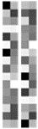
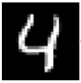
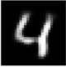
Autoencoder: Review
AutoEncoder maps input to a smaller spatial size output using an Encoder,
then map it back to output with a larger spatial size using a Decoder
Decoder 1
Encoder 1
-
-
-
-
-
-
-
-
-
-
-
reduced
input
reconstructed
Computer Vision

Slide 28
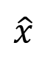
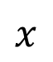
Autoencoder: Reconstruction
Trained for reconstruction with no labels!
Autoencoding = encoding itself
L2 Loss
Encoder
Decoder
$$x$$
$$\hat{x}$$
Computer Vision

Slide 29
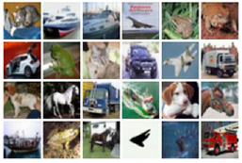
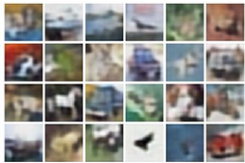
Autoencoder: Reconstruction
Trained for reconstruction with no labels!
Use bigger and deeper Encoder/Decoder for hi-res and hi-quality images
Encoder
Decoder
Input Data
Reconstructed input data
Computer Vision

Slide 30
Autoencoder: Generative Model?
Autoencoder is capable of reproducing input data.
But Autoencoder is not (yet) a Generative Model
Encoder
Decoder
Input Data
Reconstructed input data
Computer Vision

Slide 31
Autoencoder: Feature Learning
What AutoEncoder does is mapping (unsupervised feature learning),
Extract useful information (maybe object identities, properties, scene type, etc.)
Can be used for downstream tasks (transfer learning, initialize weights, etc.)
Not generating new data (not probabilistic)
Computer Vision

Slide 32
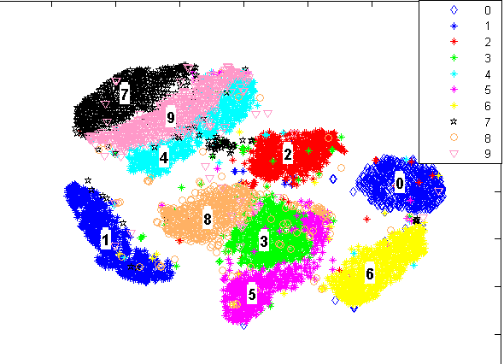
Autoencoder: Feature Learning
The basic problem is that the latent space results are not continuously distributed.
Unknown mean and variance
The encoding vector results are clustered and separated based on data
Computer Vision

Slide 33
Autoencoder: Feature Learning
This is applicable if our goal is to replicate the input data
For example: Image coloring,
the structure of the output image must not change from the input
Or because we want to be used for classification cases
Separation of latent space makes it easier to classify
To initialize a supervised model
Computer Vision

Slide 34
Autoencoder: Generative Model?
But for the Generative Model, we want to produce data that is completely new, but similar to input
To achieve this, the latent space distribution must be continuous
Spread evenly for all data encoding with known mean and variance
If latent space has discontinuity (distance between clusters), the resulting image will be strange and unrealistic
Computer Vision

Slide 35
Variational Autoencoder
Computer Vision

Slide 36
Variational Autoencoder
The difference with the standard AE is that,
Encoder
Decoder
$$x$$
$$\hat{x}$$
Computer Vision

Slide 37
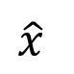
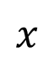
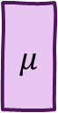
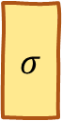
Variational Autoencoder
The difference with the standard AE is that, during the training process,
VAE encoding output (in the middle) is not just mapping input to output
Encoder
$$σ$$
Decoder
sample
$$μ$$
$$x$$
$$\hat{x}$$
Computer Vision

Slide 38
Variational Autoencoder
VAE maps input to output data distribution containing prior mean and covariance (standard deviation) of the entire dataset
Encoder
$$σ$$
Decoder
sample
$$μ$$
$$x$$
$$\hat{x}$$
Computer Vision

Slide 39
Variational Autoencoder
The encoder does not learn to reduce data, But learns to summarize the dataset,
how the average distribution of attributes over its covariance,
the relationship between attributes
Encoder
$$σ$$
Decoder
sample
$$μ$$
$$x$$
$$\hat{x}$$
Computer Vision

Slide 40
Variational Autoencoder
In the Decoder side, we sample data (generate latent space randomly) based on the mean and covariance (standard deviation) obtained
Encoder
$$σ$$
Decoder
sample
$$μ$$
$$x$$
$$\hat{x}$$
Computer Vision

Slide 41
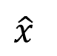
Variational Autoencoder
The results of this random latent space are then given to the decoder to generate images
Encoder
$$σ$$
Decoder
sample
$$μ$$
$$x$$
$$\hat{x}$$
Computer Vision

Slide 42
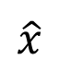
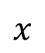
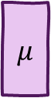

Variational Autoencoder
In this way, generations are raised stochastically
Encoder
$$σ$$
Decoder
sample
$$μ$$
$$x$$
$$\hat{x}$$
Computer Vision

Slide 43
Variational Autoencoder
That for the same input, even though it produces the same mean and standard deviation,
The results of the encoding will be different each time it is tried because it is generated randomly (not just mapping)
Encoder
$$σ$$
Decoder
sample
$$μ$$
$$x$$
$$\hat{x}$$
Computer Vision

Slide 44
Variational Autoencoder
And from these different encodings, different images can also be generated
The process will produce encoding vectors (Latent Space) from the continuously distributed VAE
Encoder
$$σ$$
Decoder
sample
$$μ$$
$$x$$
$$\hat{x}$$
Computer Vision

Slide 45
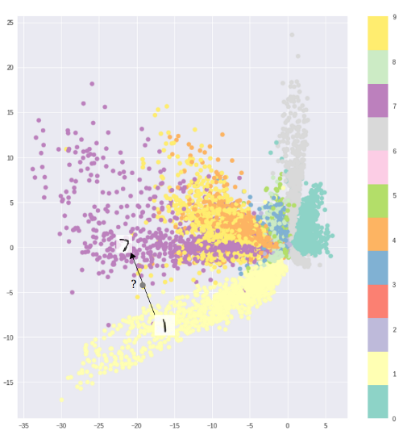
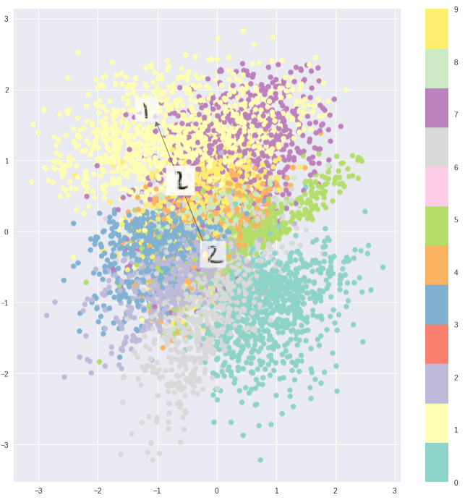
Variational Autoencoder
Computer Vision

Slide 46
Variational Autoencoder Step-by-step
Computer Vision

Slide 47
Variational Autoencoder
Probabilistic spin on autoencoders
Targets:
Learn latent features z from raw data
Sample from the model to generate new data
Intuition
x is an image,
z is latent factors used to generate x:
class, attributes, orientation, etc
Computer Vision

Slide 48
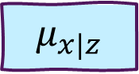
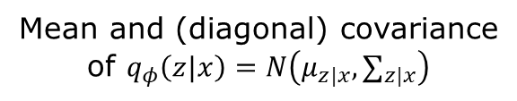
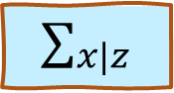
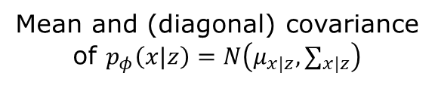
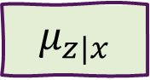


Variational Autoencoder: Model
Mean and (diagonal) covariance of $q_{φ}\left(z|x\right)=N\left(μ_{z|x},∑_{z|x}\right)$
Mean and (diagonal) covariance of $p_{φ}\left(x|z\right)=N\left(μ_{x|z},∑_{x|z}\right)$
$$≈$$
$$μ_{z|x}$$
$$∑_{z|x}$$
$$μ_{x|z}$$
$$∑_{x|z}$$
x
z
Data point
Latent state
Encoder Network
Decoder Network
Kingma and Welling, “Auto-Encoding Variational Bayes”, ICLR 2014
Computer Vision

Slide 49









Variational Autoencoder: Model Example
$x:\left[28×28\right]$ image, flattened to 784-dim vector
$z:$ 20-dim vector
Encoder Network
$$p_{φ}\left(x|z\right)=N\left(μ_{z|x},∑_{z|x}\right)$$
Decoder Network
$$p_{φ}\left(x|z\right)=N\left(μ_{x|z},∑_{x|z}\right)$$
$μ^{x}$: 20
$Σ^{x}$: 20
$μ^{x}$: 784
$Σ^{x}$: 784
Linear (400,20)
Linear (400,20)
Linear (400,784)
Linear (400,784)
Linear (784,400)
Linear (20,400)
$x$: 784
$z$: 20
Computer Vision

Slide 50


Variational Autoencoder: Math
$$\log{p_{θ}\left(x\right)}$$
$$= Ε_{z\sim q_{φ}}\left[\log{p_{θ}\left( x | z \right)}\right]−D_{KL}\left(q_{φ}\left( z | x \right),p_{θ}\left(z\right)\right)$$
$$+ D_{KL}\left(q_{φ}\left( z | x \right),p_{θ}\left( z | x\right)\right)$$
Data reconstruction (1)
KL-Divergence (2)
(1) Expectation of generated data sampled from latent space z
(2) KL divergence between prior and samples from the encoder.
Latent states should follow the prior
Kingma and Welling, “Auto-Encoding Variational Bayes”, ICLR 2014
Computer Vision

Slide 51



Variational Autoencoder: Math
$$\log{p_{θ}\left(x\right)}$$
$$= Ε_{z\sim q_{φ}}\left[\log{p_{θ}\left( x | z \right)}\right]−D_{KL}\left(q_{φ}\left( z | x \right),p_{θ}\left(z\right)\right)$$
$$+ D_{KL}\left(q_{φ}\left( z | x \right),p_{θ}\left( z | x\right)\right)$$
$\} ℒ\left(x^{\left(i\right)}, θ,φ\right)$ “Elbow” (4)
$\}≥0$ (3)
(3) Cannot be computed. can be removed with the condition KL has to be $≥$0
(4) Elbow: Variational Lower bound on the data likelihood
Kingma and Welling, “Auto-Encoding Variational Bayes”, ICLR 2014
Computer Vision

Slide 52

Variational Autoencoder: Math
$$\log{p_{θ}\left(x\right)} ≥ Ε_{z\sim q_{φ}}\left[\log{p_{θ}\left( x | z \right)}\right]−D_{KL}\left(q_{φ}\left( z | x \right),p_{θ}\left(z\right)\right)$$
Train to maximize lower bound
$$θ^{∗}, φ^{∗}=\text{arg} \max_{θ,φ}{\sum_{i=1}^{N}{ℒ\left(x, θ, φ\right)}}$$
Kingma and Welling, “Auto-Encoding Variational Bayes”, ICLR 2014
Computer Vision

Slide 53





Variational Autoencoder: Forward
$$\log{p_{θ}\left(x\right)} ≥ Ε_{z\sim q_{φ}}\left[\log{p_{θ}\left( x | z \right)}\right]−D_{KL}\left(q_{φ}\left( z | x \right),p_{θ}\left(z\right)\right)$$
Should be close to prior $p_{θ}(z)$
$$μ^{z}$$
$$Σ^{z}$$
Mean and (diagonal) covariance of $q_{φ}\left( z \right| x )$
Encoder Network
$$x$$
Data point
Computer Vision

Slide 54



Variational Autoencoder: Forward
$$\log{p_{θ}\left(x\right)} ≥ Ε_{z\sim q_{φ}}\left[\log{p_{θ}\left( x | z \right)}\right]−D_{KL}\left(q_{φ}\left( z | x \right),p_{θ}\left(z\right)\right)$$
Sample from $q_{φ}\left( z \right| x )$
$$z$$
Regularization toward prior in middle
$$μ^{z}$$
$$Σ^{z}$$
Mean and (diagonal) covariance of $q_{φ}\left( z \right| x )$
Should be close to prior $p_{θ}(z)$
Encoder Network
$$x$$
Data point
Computer Vision

Slide 55


Variational Autoencoder: Forward
$$\log{p_{θ}\left(x\right)} ≥ Ε_{z\sim q_{φ}}\left[\log{p_{θ}\left( x | z \right)}\right]−D_{KL}\left(q_{φ}\left( z | x \right),p_{θ}\left(z\right)\right)$$
$$μ^{x}$$
$$Σ^{x}$$
Mean and (diagonal) covariance of$p_{θ}\left( x \right| z )$
Should be close to data x
Decoder Network
Sample from $q_{φ}\left( z \right| x )$
$$z$$
Regularization toward prior in middle
$$μ^{z}$$
$$Σ^{z}$$
Mean and (diagonal) covariance of $q_{φ}\left( z \right| x )$
Should be close to prior $p_{θ}(z)$
Encoder Network
$$x$$
Data point
Computer Vision

Slide 56




Variational Autoencoder: Training
Reconstructed
$$\hat{x}$$
Sample from $p_{θ}\left( x \right| z )$
Reconstruction loss at the end
$$μ^{x}$$
$$Σ^{x}$$
Mean and (diagonal) covariance of$p_{θ}\left( x \right| z )$
Should be close to data x
Decoder Network
Sample from $q_{φ}\left( z \right| x )$
$$z$$
Regularization toward prior in middle
$$μ^{z}$$
$$Σ^{z}$$
Mean and (diagonal) covariance of $q_{φ}\left( z \right| x )$
Should be close to prior $p_{θ}(z)$
Encoder Network
$$x$$
Data point
Computer Vision

Slide 57






Variational Autoencoder: Testing
Generated data
$$\hat{x}$$
Sample densely from $p_{θ}\left( x | z \right)$ to generate data
$$μ^{x}$$
$$Σ^{x}$$
Run sampled z through decoder to
get distribution over data x
Decoder Network
$$z$$
Sample from prior $p_{θ}\left( x \right| z )$
Computer Vision

Slide 58
Variational Autoencoder: Generated Data
Labeled Faces in the Wild
32x32 CIFAR-10
Kingma and Welling, “Auto-Encoding Variational Bayes”, ICLR 2014
Computer Vision

Slide 59


Variational Autoencoder: Generated Data
The diagonal prior on p(z) causes dimensions of z to be independent
“Disentangling factors of variation”
Flavor of AutoEncoder
Not only learning to generate data
Also learning to represent data through latent code z
Manipulating latent codes have some effect to the generated data
Vary $z_{1}$
Vary $z_{2}$
Kingma and Welling, “Auto-Encoding Variational Bayes”, ICLR 2014
Computer Vision

Slide 60








Variational Autoencoder: Modify/Edit Image
Edited Data
$$\hat{x}$$
$$μ^{x}$$
$$Σ^{x}$$
Run input data through encoder to get a distribution over latent codes
Sample code z from encoder output
Modify some dimensions of sampled code
Run modified z through decoder to get a distribution over data samples
Sample new data from (4)
Decoder Network
Modified code
$$z′$$
Latent code
$$z$$
$$μ^{z}$$
$$Σ^{z}$$
Encoder Network
Input Data
$$x$$
Computer Vision

Slide 61



Variational Autoencoder: Modify/Edit Image
The diagonal prior on p(z) causes dimensions of z to be independent
“Disentangling factors of variation”
Test and observe to find the representation of a dimension
No control over what the latent learns
Vary $z_{1}$ (degree of smile)
Vary $z_{2}$ (head pose)
Kingma and Welling, “Auto-Encoding Variational Bayes”, ICLR 2014
Computer Vision

Slide 62
Variational Autoencoders: Modify/Edit Image
Kulkarni et al, “Deep Convolutional Inverse Graphics Networks”, NeurIPS 2014
Computer Vision

Slide 63
Variational Autoencoders: Summary
Probabilistic spin to traditional autoencoders => allows generating data
Defines an intractable density => derive and optimize a (variational) lower bound
Computer Vision

Slide 64

Variational Autoencoders: Summary
Pros:
Principled approach to generative models
Allows inference of $q(z|x)$, can be useful feature representation for other tasks
Cons:
Maximizes lower bound of likelihood: okay, but not quite good evaluation
Samples blurrier and lower quality compared to state-of-the-art (GANs)
Computer Vision

Slide 65
Variational Autoencoders: Summary
Active areas of research:
More flexible approximations, e.g. richer approximate posterior instead of diagonal Gaussian, e.g., Gaussian Mixture Models (GMMs)
Incorporating structure in latent variables, e.g., Categorical Distributions
Computer Vision

Slide 66
Improving Variational Autoencoder
Computer Vision

Slide 67
Combining VAE + Autoregressive: VQ-VAE2
256 x 256 class-conditional samples, trained on ImageNet
Razavi et al, “Generating Diverse High-Fidelity Images with VQ-VAE-2”, NeurIPS 2019
Computer Vision

Slide 68
Combining VAE + Autoregressive: VQ-VAE2
Redshank
Pekinese
Papillon
Drake
Spotted Salamander
Razavi et al, “Generating Diverse High-Fidelity Images with VQ-VAE-2”, NeurIPS 2019
Computer Vision

Slide 69
Combining VAE + Autoregressive: VQ-VAE2
1024 x 1024 generated faces, trained on FFHQ
Razavi et al, “Generating Diverse High-Fidelity Images with VQ-VAE-2”, NeurIPS 2019
Computer Vision

Slide 70

NVAE: A Deep Hierarchical Variational Autoencoder
Vahdat et al, “NVAE: A Deep Hierarchical Variational Autoencoder”, NeurIPS 2020
Computer Vision

Slide 71

Break, Question?
Computer Vision

